Slide 1
WiE WSF TSC WL Performance Glibc-bench in TDX -Security
Taoshaoyu
July 21, 2022

Slide 2
Agenda
TDX Arch introduction
Glibc-bench SW Stack ( 背景，意义）
Test cases definition， KPI definition
POD design
Run Stages // 与每个case 混合在一起？
Test Result
acos / emon
memcpy / emon
Next Steps
TDX SW upgrade
Gcc 优化无效 ？？？
2

Slide 3
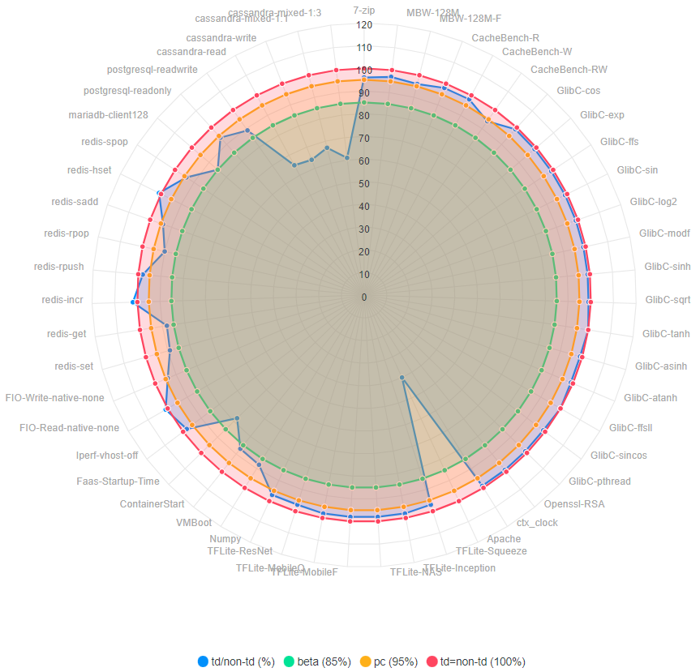
Introduce TDX
What is TDX?
To provide hardware-isolated, confidential VMs ( Trust Domain )
Mainly base on two technologies:
VMX extensions
MKTME
Known performance drop
> 90% WLs, TDX performance close to regular VM
< 10% WLs, TDX performance drop obviously
The goal of workload “glibc-bench in TDX”
To deep dive the root cause of performance drop
Try to improve it at OS level
http://cpio-devops-pub.sh.intel.com/tdx/tdx_spr_perf.html
3
Notes:
http://cpio-devops-pub.sh.intel.com/tdx/tdx_spr_perf.html

Slide 4
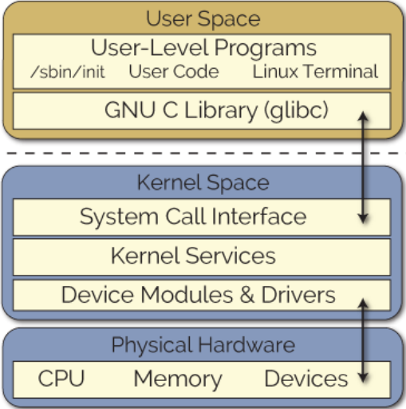
Glibc-bench SW Stack
What is “glibc”
Core library of Linux system
Foundational facilities APIs: open, read, write, malloc, printf, pthread_create…
System call to kernel space
What is “glibc-bench”
The source code is in package “glibc”
Used to measure the performance of a part of the glibc APIs
math, string operation, memory allocate, thread create
Multiple iterative calls one api, measuring time consumption with TSC （Time stamp counter )
Multi instruction sets performance comparison
For X86 Arch: SSE, AVX2, AVX512…
4

Slide 5
Test cases definition
The pain points of test cases definition
Massive data
Poor consistency
 | Count | Comment
category | 6 | malloc, math, pthread, string, stdlib, stdio-common
binary file | 188 | bench-malloc, bench-cos, bench-pthread_create, bench-ffs, bench_sprintf , bench-memcpy …
output files | 80 | bench.out, bench-memcpy,out, bench-strcpy.out …
Results | >290000
Round | 1 | 2 | 3 | 4 | 5 | 6 | 7 | 8 | 9 | 10 | avg | std | Std / avg
Good Sample ( asinh ) | 6.698 | 6.69 | 6.686 | 6.686 | 6.692 | 6.682 | 6.688 | 6.692 | 6.25 | 6.264 | 6.602800 | 0.172977 | 0.026197
Bad Sample (ZGVeN8v_log) | 1.3894 | 1.5692 | 2.3198 | 1.3083 | 1.5103 | 1.9132 | 1.2381 | 1.3704 | 1.2524 | 1.2360 | 1.510702 | 0.333446 | 0.220722
5

Slide 6
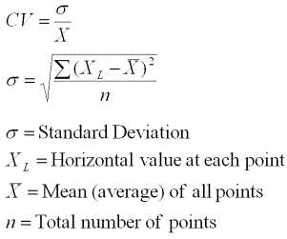
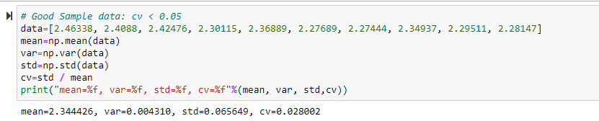
Test cases definition
Introduce CV ( coefficient of variation ) to measure the quality of data consistency
6

Slide 7
Test cases definition
How to select test cases:
All categories of case
Typical cases for every category
Good consistency (cv<0.10)
case name | category
bench-malloc-simple | malloc | 12
bench-malloc-thread | malloc | 1
All math case | math | 64
bench-pthread* | pthread | 3
bench-sprintf | stdio-common | 1
bench-strtod | stdlib | 16
bench-strcpy | string | 16
bench-memset | string | 16
bench-memcpy-large | string | 16
7

Slide 8
Resource Usage
Resource Type | Usage | Comment
Host platform CPU | SPR | Must support TDX
Host platform node | 1 | 1 node is enough
Host platform socket | 1 | 1 socket is enough
Host platform Core | >16 | Depends on SPR chip model
TDVM Numa binding | Yes | For better TDVM performance
TDVM Core binding | Yes | For better TDVM performance
TDVM Core | 16 | The maximum number of threads is 16
TDVM Memory​ | 32G | TDVM typical configuration
Storage | No special requirement
Network | No special requirement | No network related test case
8

Slide 9
POD Design and Provisioning
Single k8s node
glibc-bench (v2.35)
Workload
Container
Ubuntu 20.04
Backend
Docker / K8S (one node)
Guest OS
Centos stream 8.4
TDVM / VM
VM / BM
Centos stream 8.4
Kernel version: 5.15.0-spr.bkc.pc.3.21.0.x86_64
Host OS
CPU (SPR)
Hardware
9

Slide 10
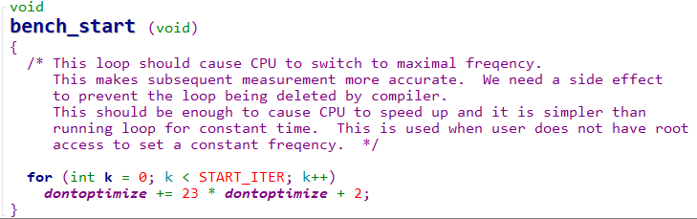
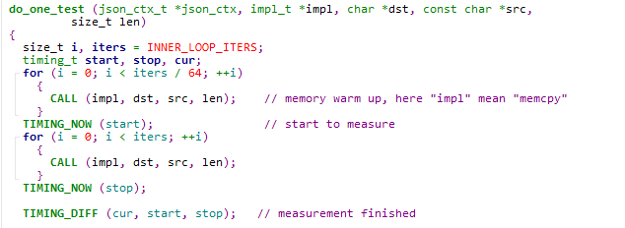
Run Stages
Time-based setup stages
No extra setup stage
Warm up stage
Glibc-bench implement self warm up code
For cpu speed sensitive test cases : Call the function “bench_start” to speed up cpu firstly
For memory related test cases: memory warm up before measuring
Formal execution stage
Run all cases: about 10m
Simple case: 1s ~ 10s
10

Slide 11
Next steps
Try new version of gcc ( gcc11 or higher )
Try build glibc with icc
Try to optimize TDVM configuration
…
11

Slide 12

Photo Example On Lower Half
Thank You
12

Slide 13
KPI definition
KPI Definition
average run time = Time Stamp Counter (TSC) required to call api once
Sample:
// output of test case “bench-acos” "acos": { "": { "duration": 2.20683e+09, "iterations": 1.29888e+08, "max": 98.082, "min": 7.998, "mean": 16.9903 } | "duration": 2.20683e+09 // The run time is 2.20683e+09 TSC in my machine, about 10s "iterations": 1.29888e+08 // Repeat call the function “acos” 1.29888e+08 times "mean": 16.9903 // The mean value is 16.9903 TSC
13

Slide 14
Backup
14

